Slide 1
ENGR 12
Dr. Mandala
Notes:
Down

Slide 2

STEP 1: Define the function
How do you let MATLAB know what is the function equation?
Example:
Method 1: Entering the function as a string (will not be supported in future)
f=‘sin(x)./(x.^2+1)’
Method 2: Creating a MATLAB function (m-file)
function y=eq1(x)
…
Method 3: Creating an anonymous function (recommended)
f=@(x)sin(x)./(x.^2+1);

Slide 3
STEP 2: analyze the function
For example, to plot the defined equation you can use fplot
>> f=@equation1;
>> fplot(f,[-10 10]);
Several MATLAB built-in functions can help analyze engineering equations
Function | description
fplot | Plots 2D mathematical function
feval | Evaluates a mathematical function
fzero | Finds roots of a mathematical function
fminbnd | Finds minima of mathematical functions
quad,quadl | Numerical integration
trapz | Trapezoidal numerical integration
diff | Numerical differentiation

Slide 4
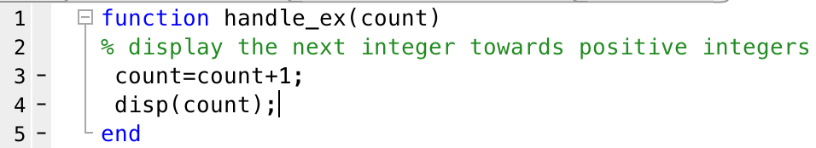
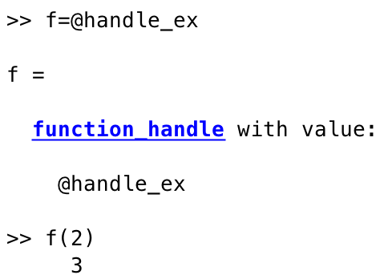
Creating Function Handle
Is a MATLAB value (data-type) that provides a means to call or invoke a function indirectly. You can even use it as an argument for other functions.
use @ next to function name to define function handle
invoke function using handle

Slide 5
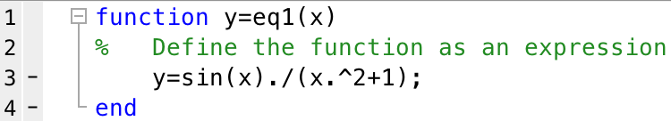
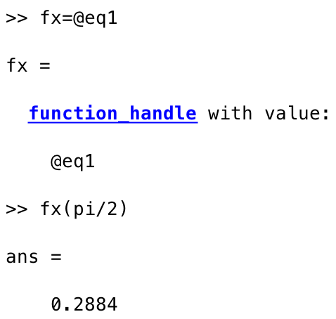

Creating function handle sample
Create function handle
Invoke function
Analyze/plot

Slide 6
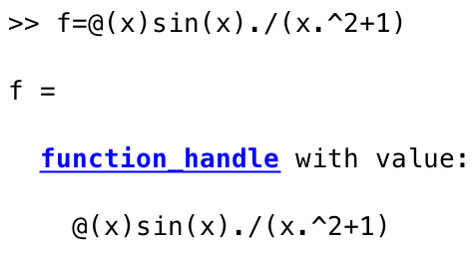
Anonymous function
Quick way to define a equation/function
Does not require a new m-file with function in it.
Create function and return handle in one step
function_handle=@(argument_list)expression
argument_list: variables in function, x, y, z etc.
expression: single MATLAB expression containing variables
Now, you can use f in all analyses methods
fplot(f,[-10 10])

Slide 7
Plotting math functions
fplot plots a mathematical function
Syntax: fplot(fun)
Plots fun (a function handle or equation as a string) between limits of the current axes (default of [-5 5]).
Syntax: fplot(fun,lims)
Plots fun (a function handle or equation as a string) between limits defined by array lims (example lims=[-10 10]).
Note to define x and y limits use [xmin xmax ymin ymax]

Slide 8
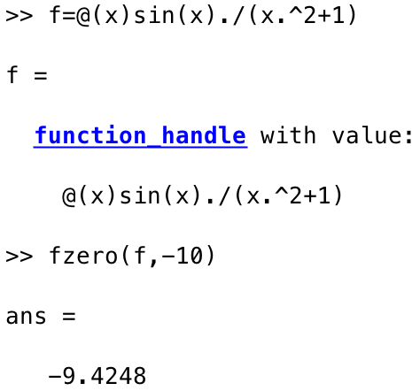
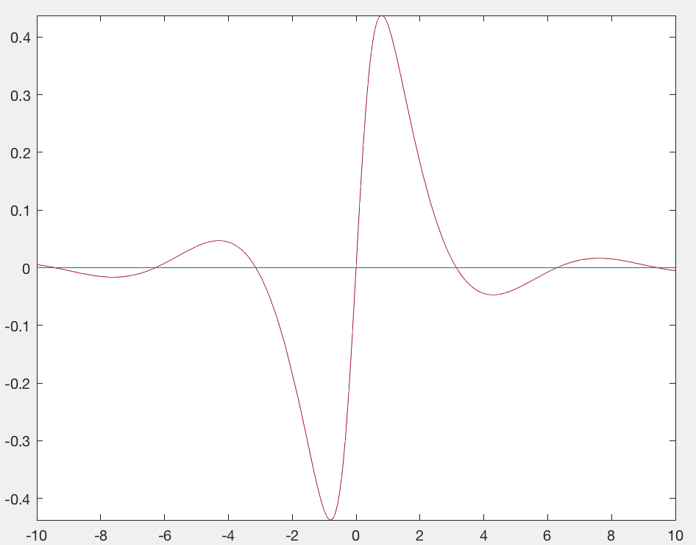
Finding Roots
fzero command returns roots of a function beginning at a starting point
fzero(fun,initial_guess)
fun=function handle
initial_guess=starting point on input variable (x)
Visual examination reveals first root is close to x=-10
fzero return x values

Slide 9
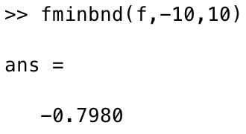
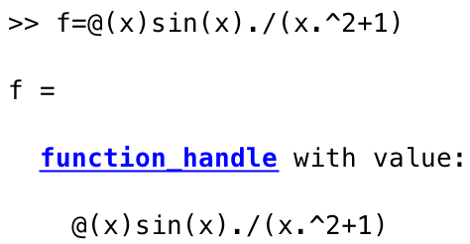
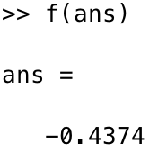
Finding local minima
fminbnd can find the local minima within a bounded x-space (or between two x-values)
fminbnd(fun,xmin,xmax)
fun= function handle
xmin=start point
xmax=end point
fminbnd returns x-values
f(x) gives y-values or the minima

Slide 10
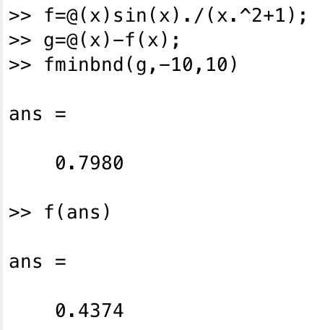
Steps to find maxima of function
Function f maxima
Define function f
Define negative of function f
Find minima for function g
Find function f value for minima of function g

Slide 11
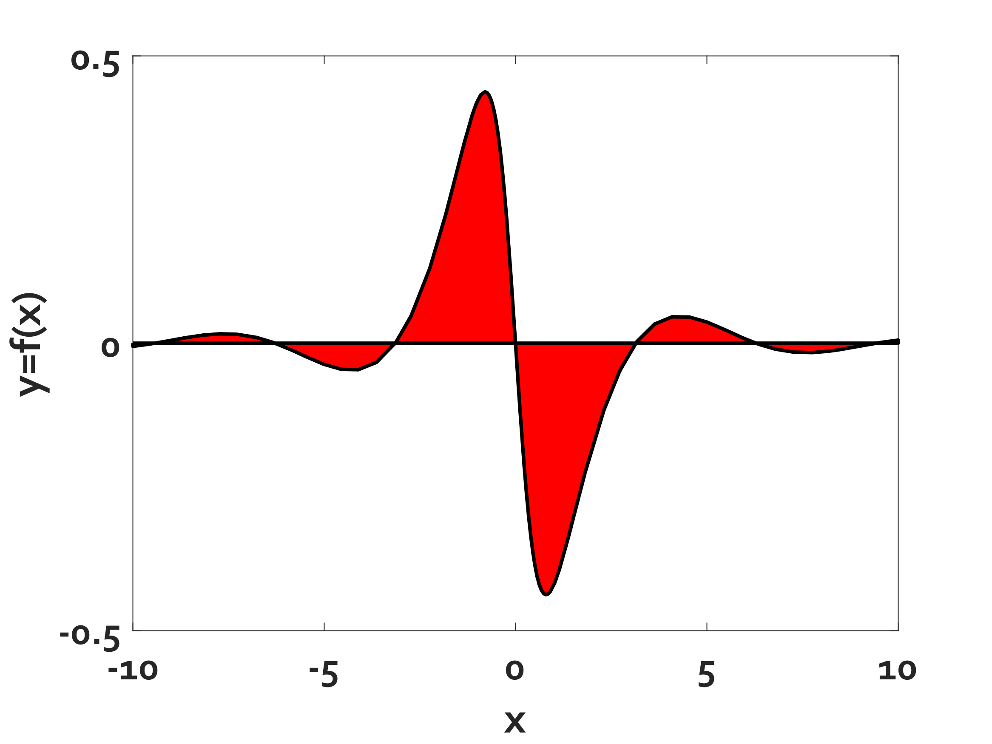
Numerical integral
Integral over function:
Find area between roots and sum them all
Method 1: Use trapz
trapz(x,f(x))
x=array of x-values
f(x)=array of corresponding y-values
Method 2: Use quad or quadl
quad(fun,xroot1,xroot2)
quadl(fun,xroot1,xroot2)
fun=function handle
xroot1=x-value of root 1
xroot2=x-value of root 2
Area1+Area2+Area3+Area4+Area5+Area6
Notes:
Refer to in-class demo

Slide 12

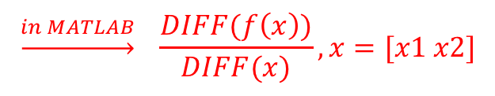
Numerical Differentiation
Much more complex!
To find differential at a point, use diff to calculate slopes
diff(fun,x_bounds)
fun=function handle
x_bound=an array containing xmin and xmax
Using diff finds differential at mid-point of xmin and xmax
$$\underset{→}{in MATLAB} \frac{DIFF(f\left(x\right))}{DIFF(x)}, x=[x1 x2]$$

Slide 13
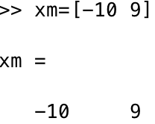
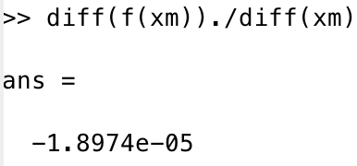
Numerical Differentiation method
Define function
Create an x-values array
Calculate differential

Slide 14
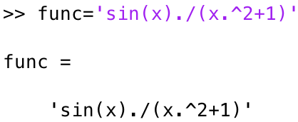
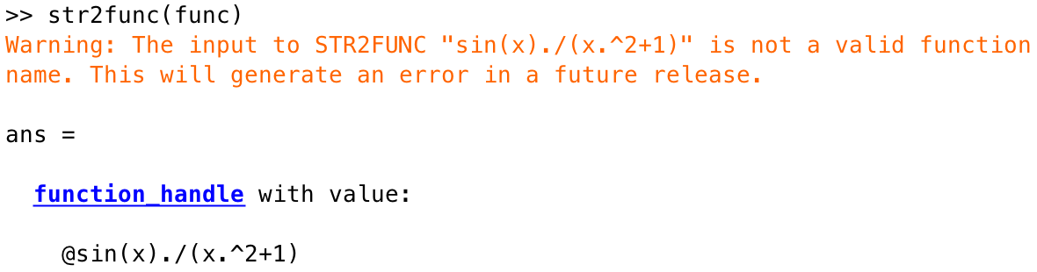
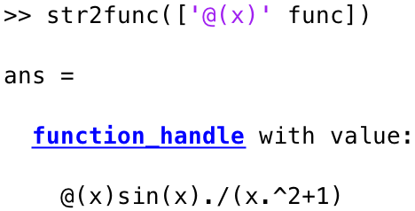
Convert a string into function
func contains a string representing the function
Does not look like anonymous function handle!
Concatenate ‘@(x)’ and voila! Looks like anon function now.^{magic}

Slide 15
Download handout
Download Handout

